Slide 1
Layout titolo
Sottotitolo

Slide 3
What we wanted it to be:
Something that actually moves around without catching fire
(it actually catched fire at some point)
Something that can be controlled remotely
Something that somehow perceives it’s proximities

Slide 4
CM-01 Automatic Car
What we wanted it to be:
What we achieved:
Something that actually moves around without catching fire
(it actually catched fire at some point)
Something that can be controlled remotely
Something that somehow perceives it’s proximities
Mobility: 4 wheels, controlled in pairs
Remote Control:
Wifi: using ESP8266
Infrared remote
Proximity sensing:
HCSR04 ultrasonic range sensor + servo for scanning at 180°
IR range sensor for line following

Slide 5
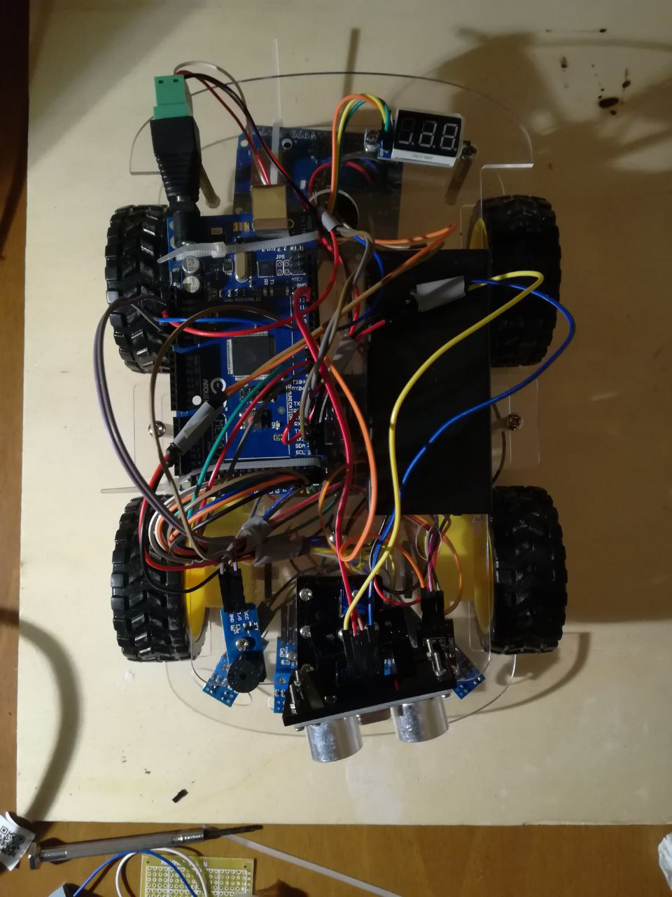
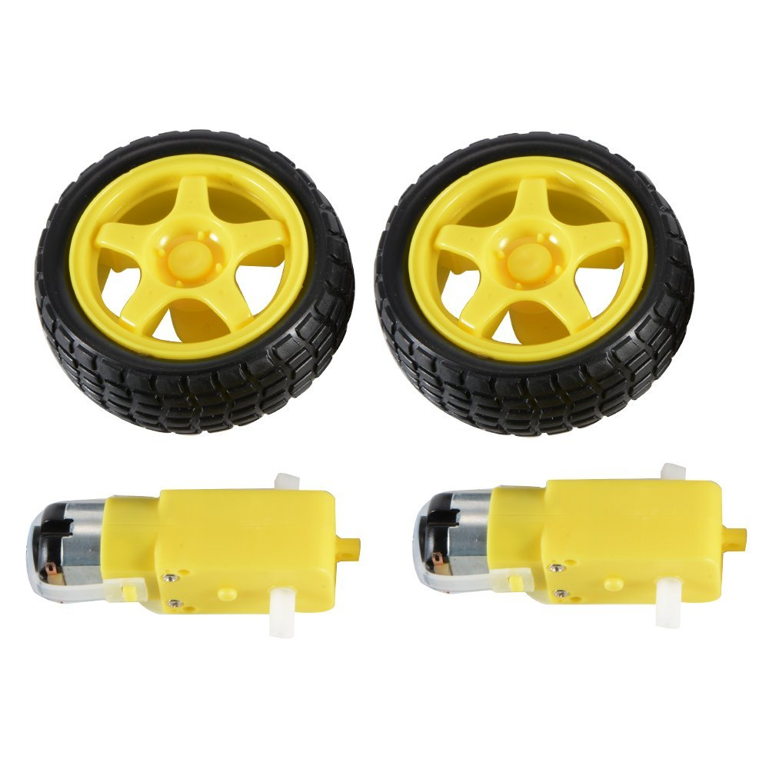
Components:
DC motors + Wheels:
Sold in couples, 5 euros on Amazon, much less on Aliexpress.
Rated 3V – 6V

Slide 6
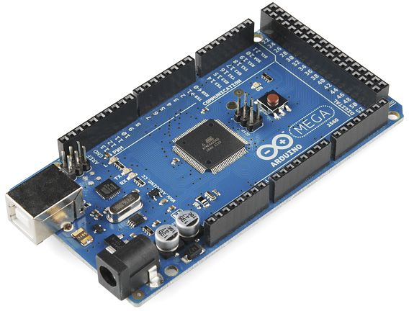
Components:
Arduino Mega 2560 REV3
Has LOTS of GPIO pins, PWM-enabled pins and Analog pins
Multiple Serial interfaces
Same layout of Arduino Uno for shield compatibility

Slide 7
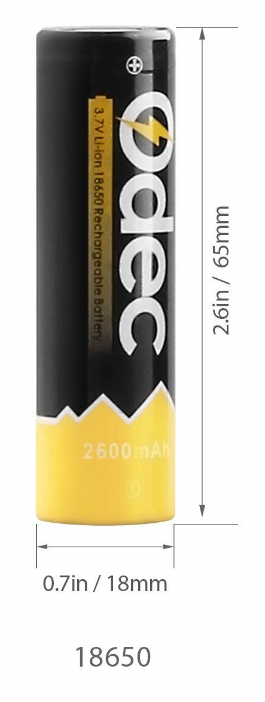
Components:
2x 18650 Li-ion cells
3.6V each (actually almost 4V when fully charged)
!!Faulty battery socket can make them catch fire!!
But as long as you’re careful it should be ok

Slide 8
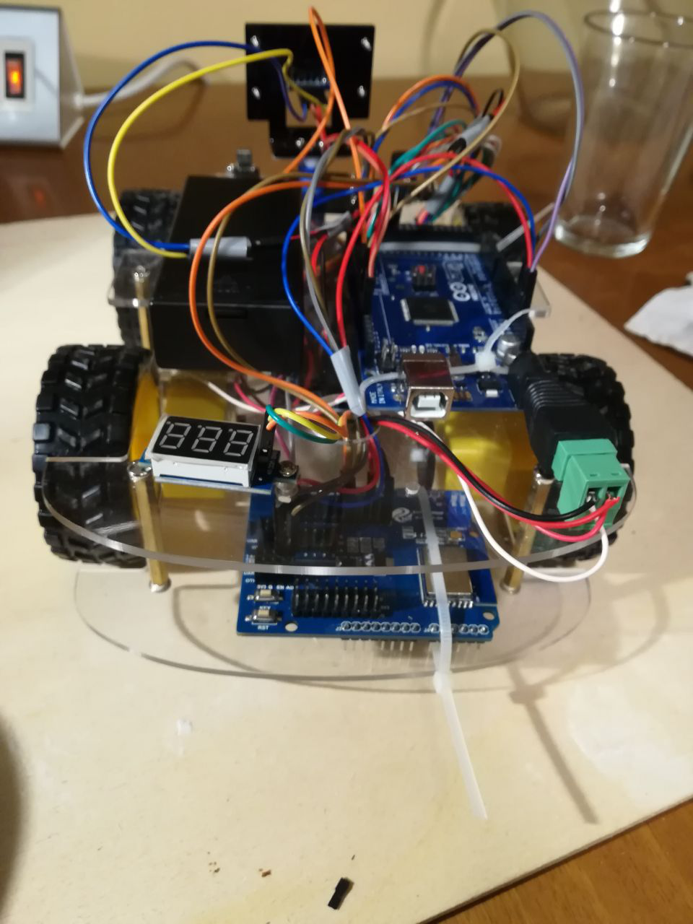
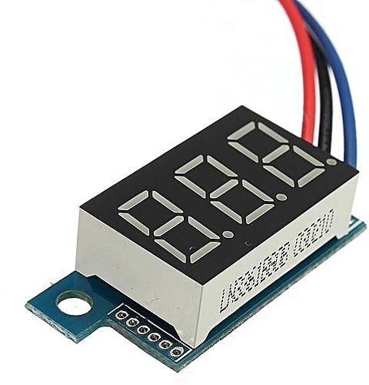
Components:
Voltage meter:
Small
Not very accurate but it’s used only for battery charge status estimation

Slide 9
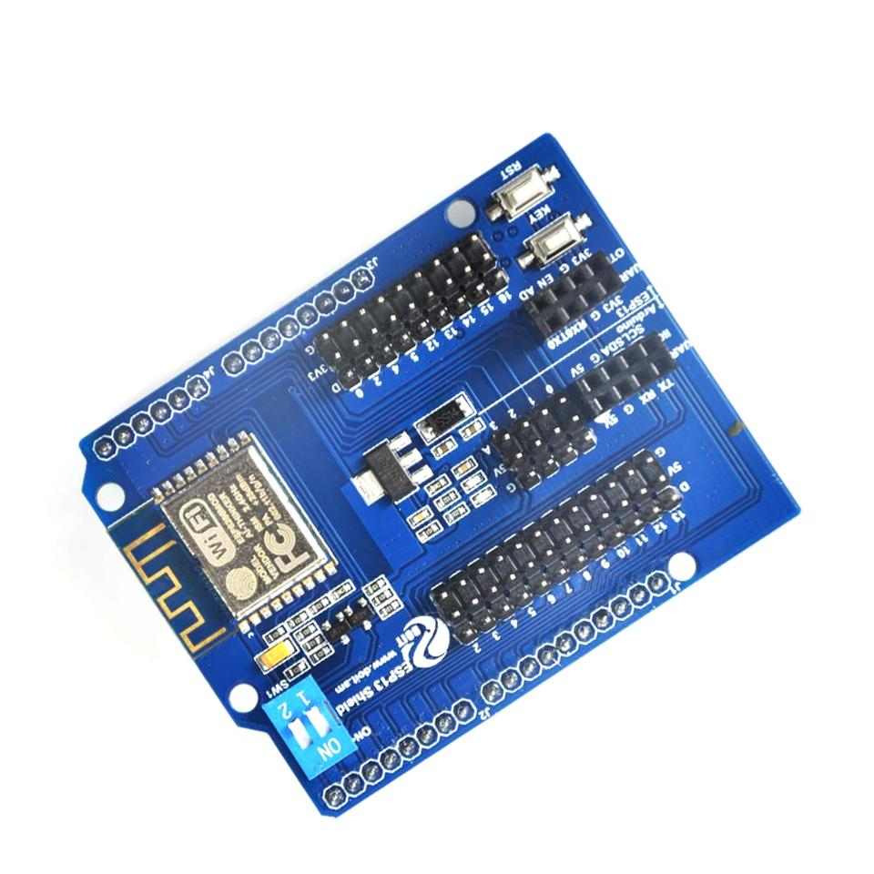
Components:
ESP-13 shield
Carries an ESP-WROOM-02 module based on ESP8266
Not mounted as a shield (going to see why soon)
Cheap compared to other ESP8266 shields
Turns out there’s a reason for that

Slide 10
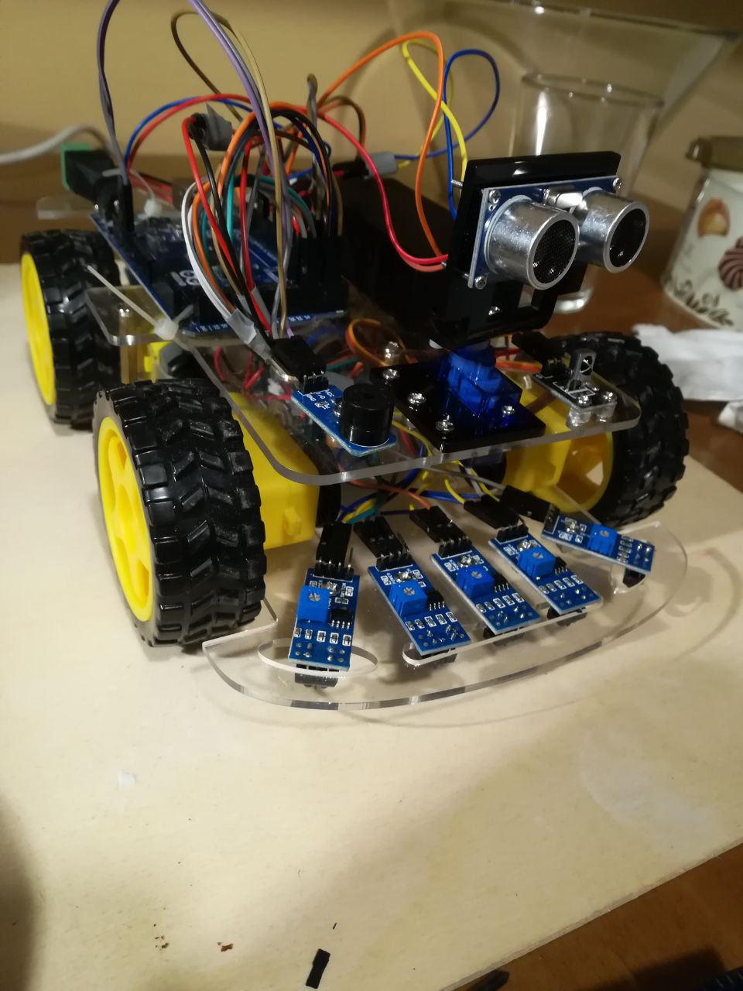
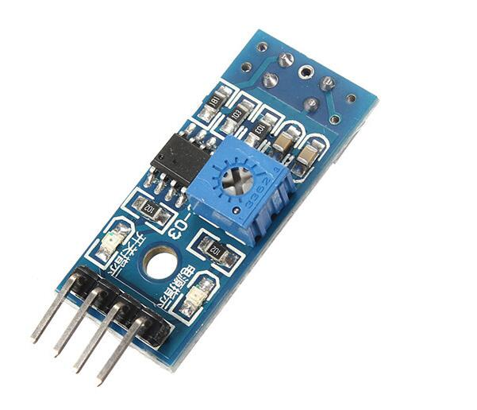
Components:
5X IR proximity sensing modules
Contains an LML393 comparator by ON Semiconductor coupled with a TRT5000 sensor by Vishay
Functioning explained later
Used to let the car follow a black line on the terrain

Slide 11
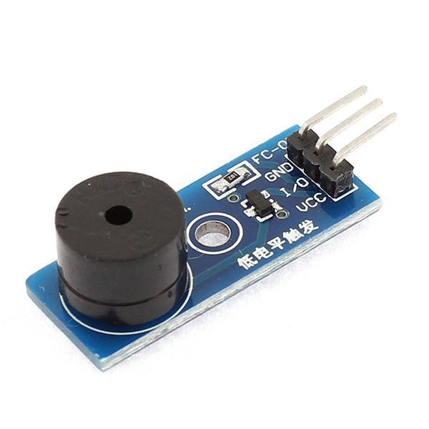
Components:
Piezo Active Buzzer Module
Rated for 3.3V-5V (transistor onboard for power mode switching)
Different from passive buzzer:
Can generate a fixed tone when I/O is HIGH (3.3V)
Con: no frequency control
Pro: doesn’t require a pre-generated waveform

Slide 12
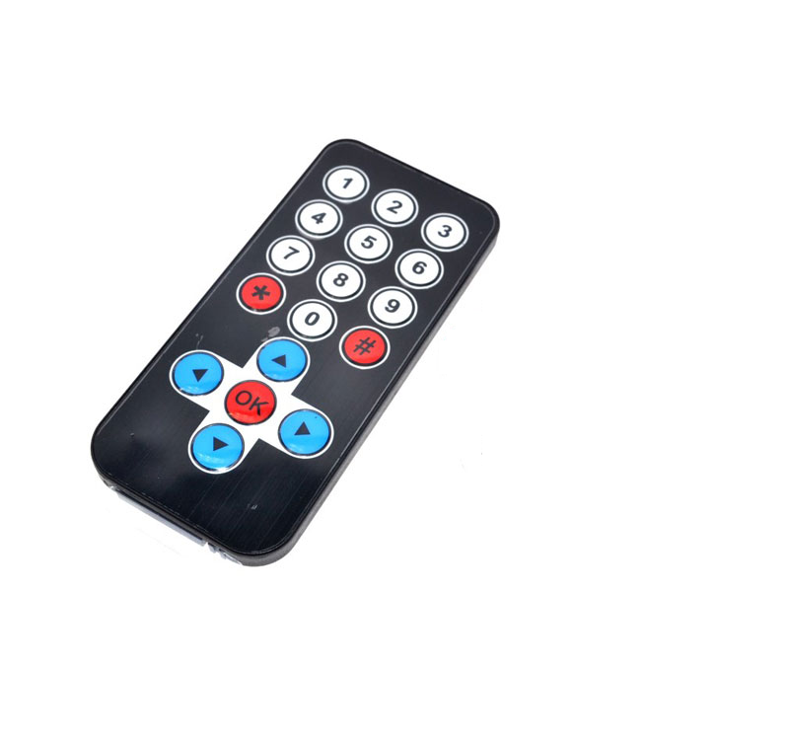
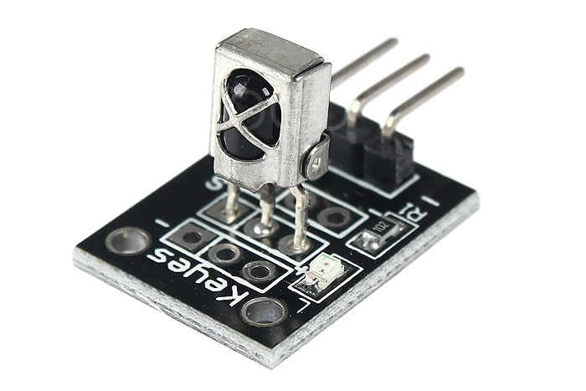
Components:
IR receiver module
Basically a TL1838 Infrared Receiver mounted on a pcb + LED to signal incoming IR message
Allows car to receive signals from any el-cheapo IR transmitter or remote control

Slide 13
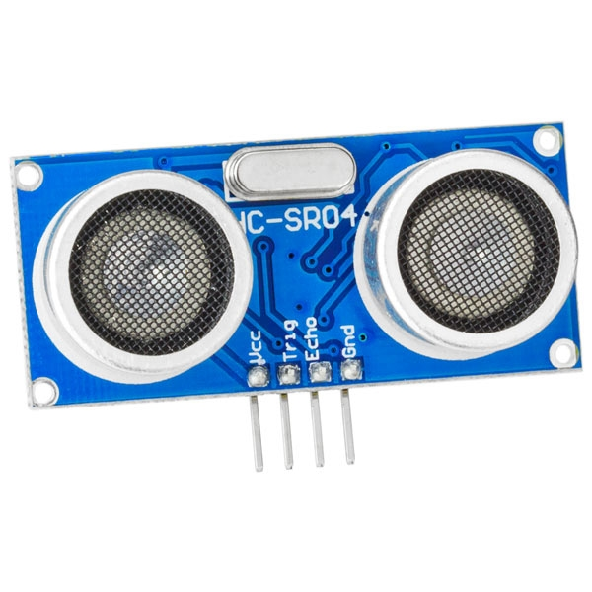
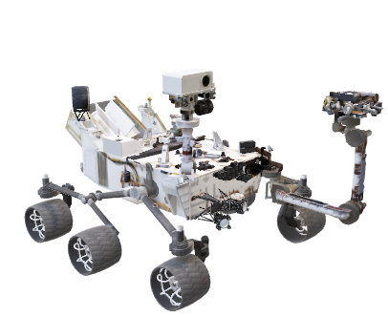
Components:
HCSR04 Ultrasonic Ranging Module:
A couple of transducers, one for transmitting and one for receiving are used to measure an echo delay, thus estimating a linear distance from the sensor itself.
Mounted on a rotating support ot scan multiple directions
Kinda makes the whole thing look like the Curiosity rover

Slide 14
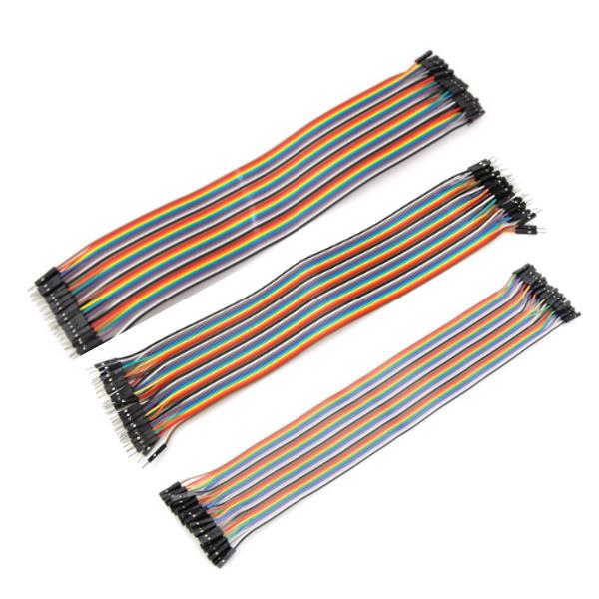
Components:
Jumper Wires
Everything is connected using jumper wires:
MtF
MtM
FtF

Slide 15
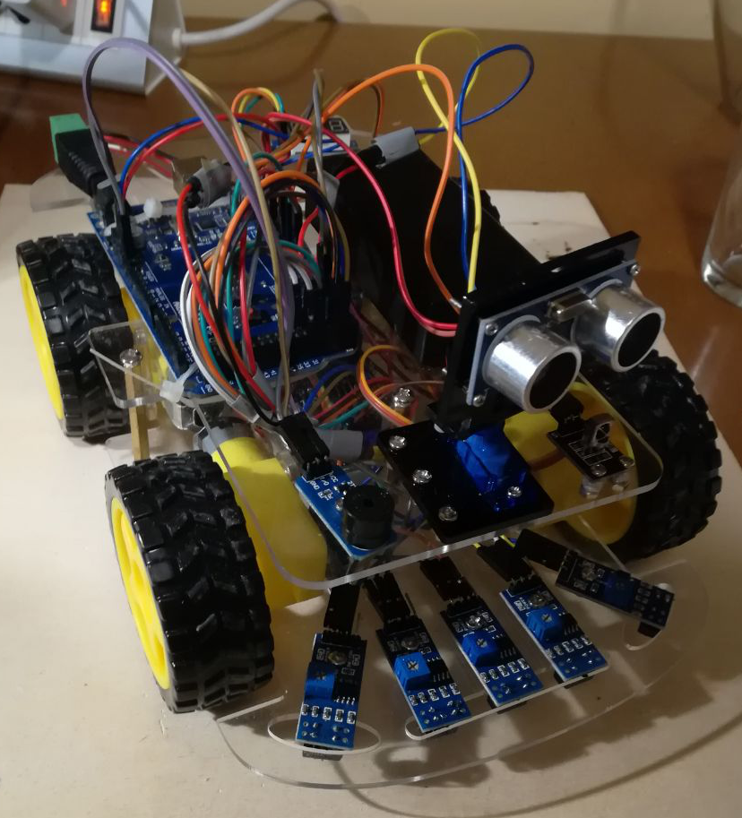
Components:
Piezo Active Buzzer Module
Rated for 3.3V-5V (transistor onboard for power mode switching)
Different from

Slide 16
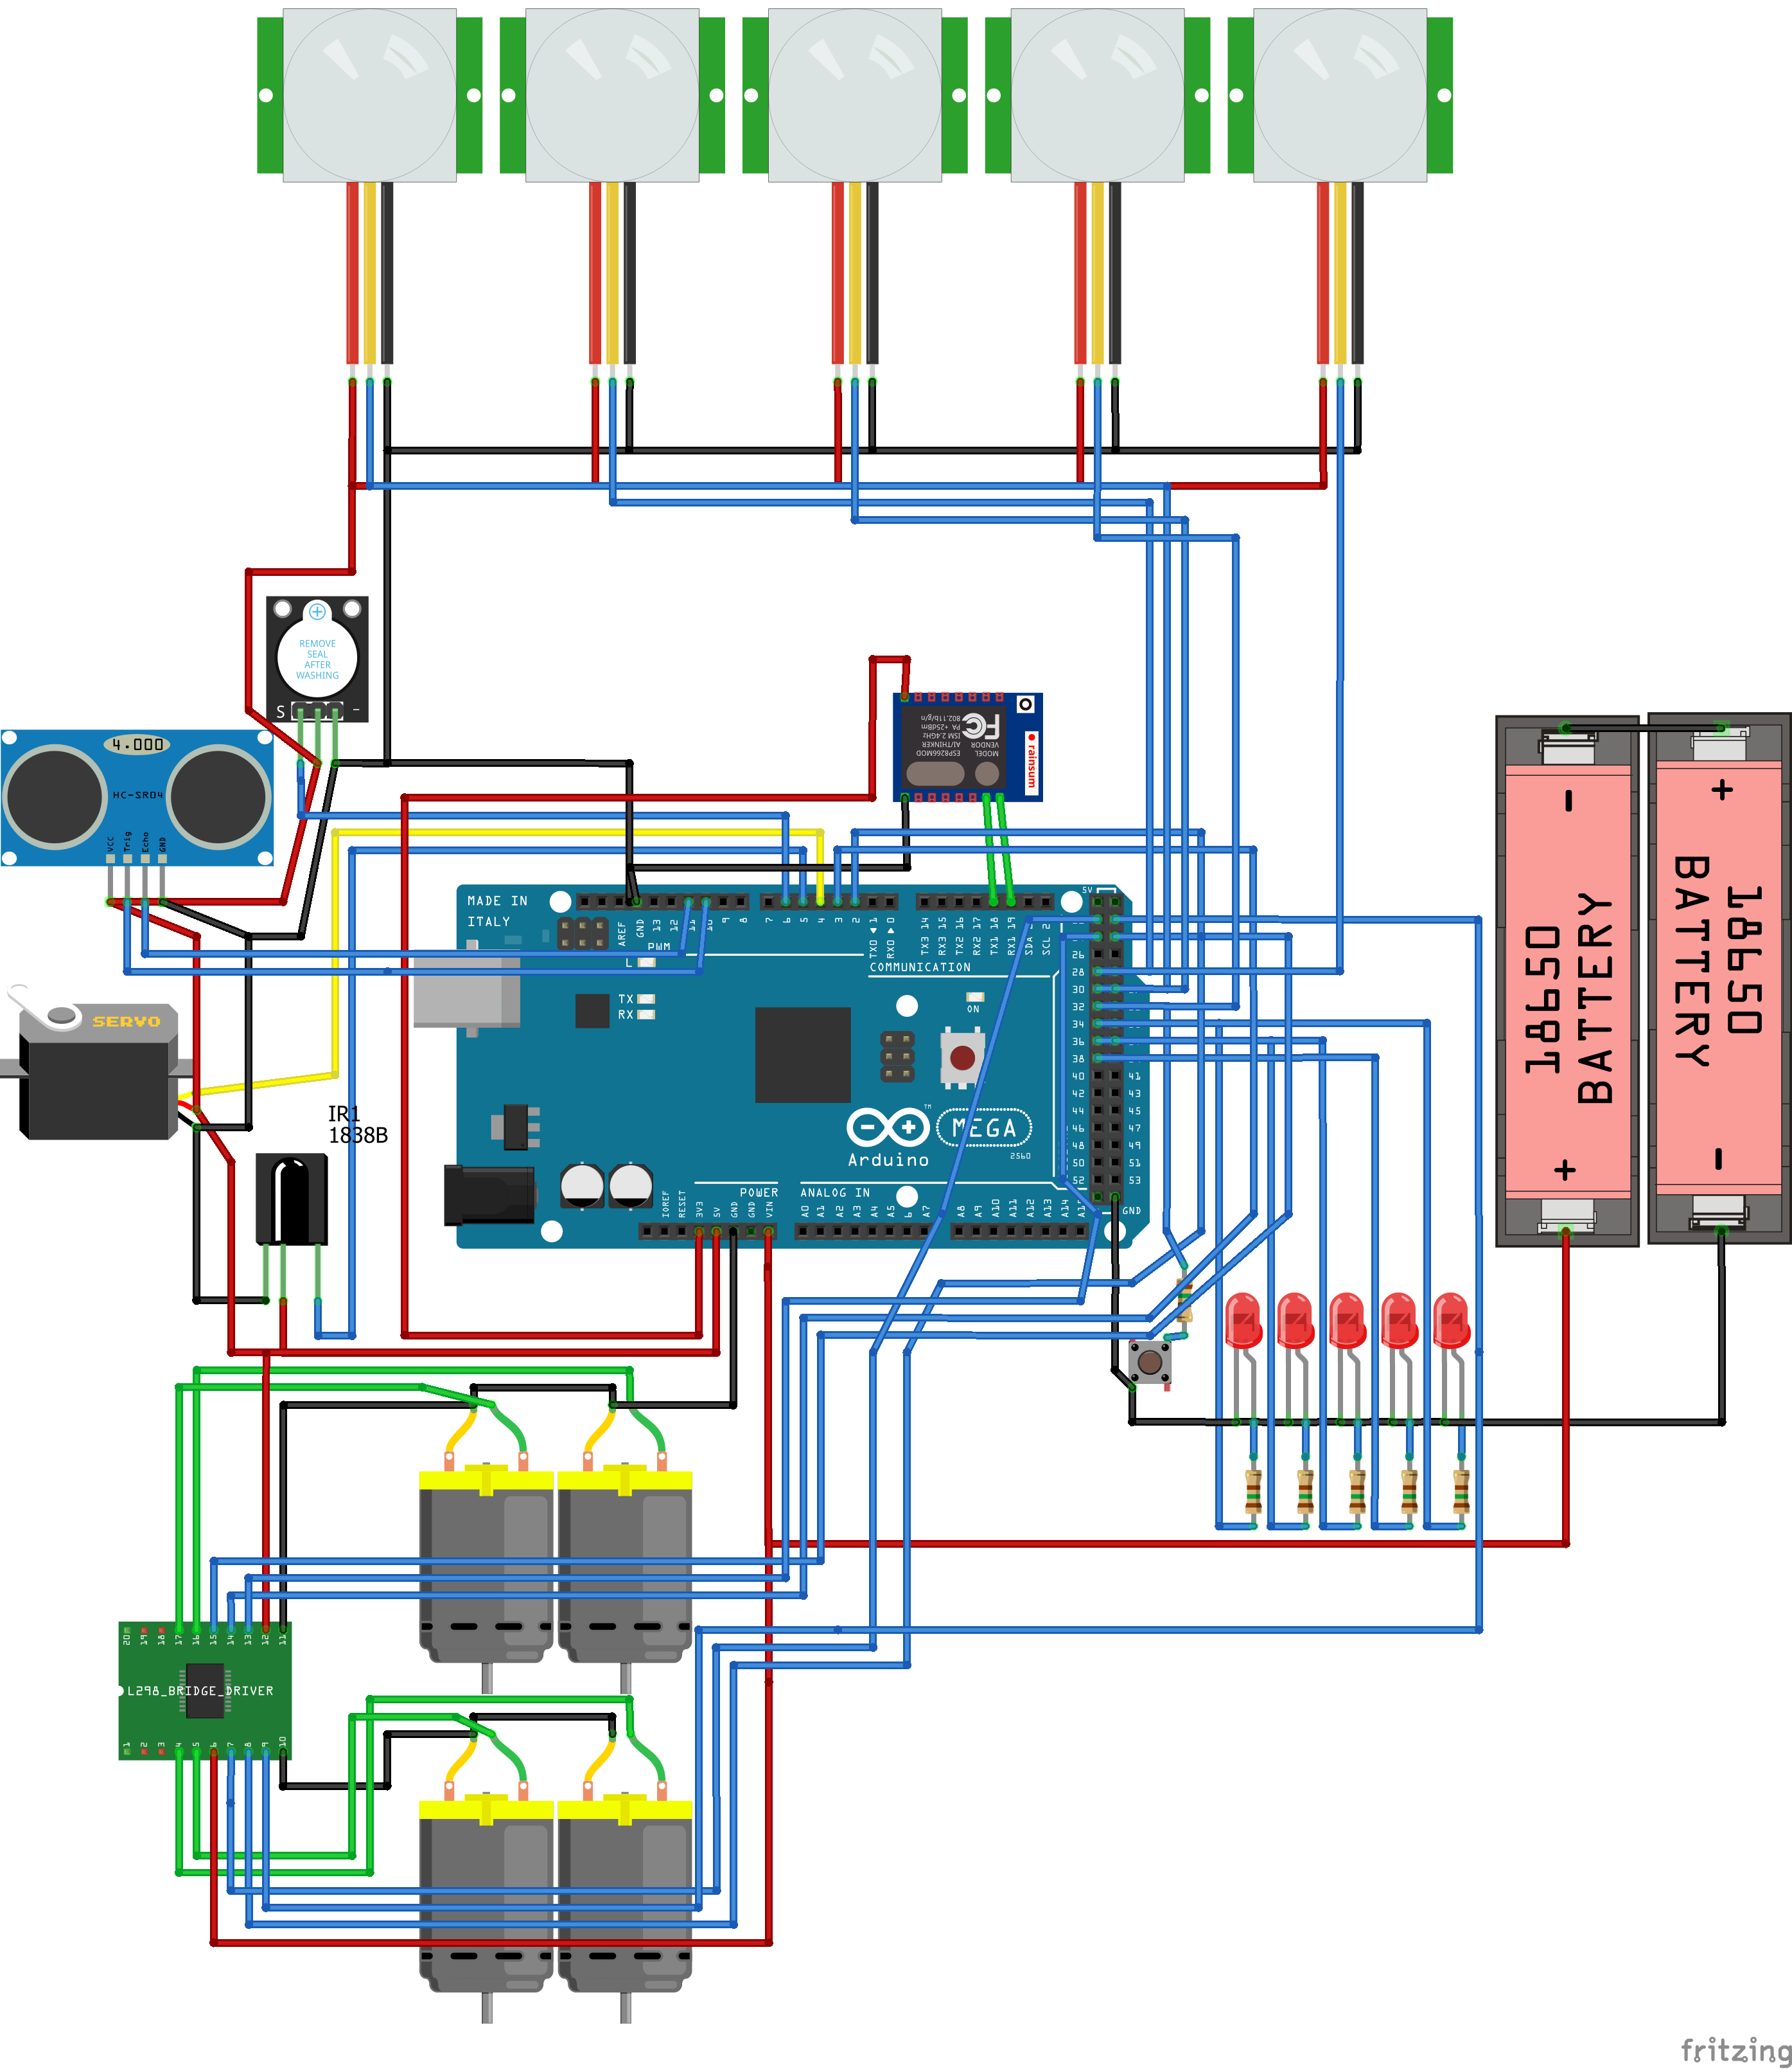
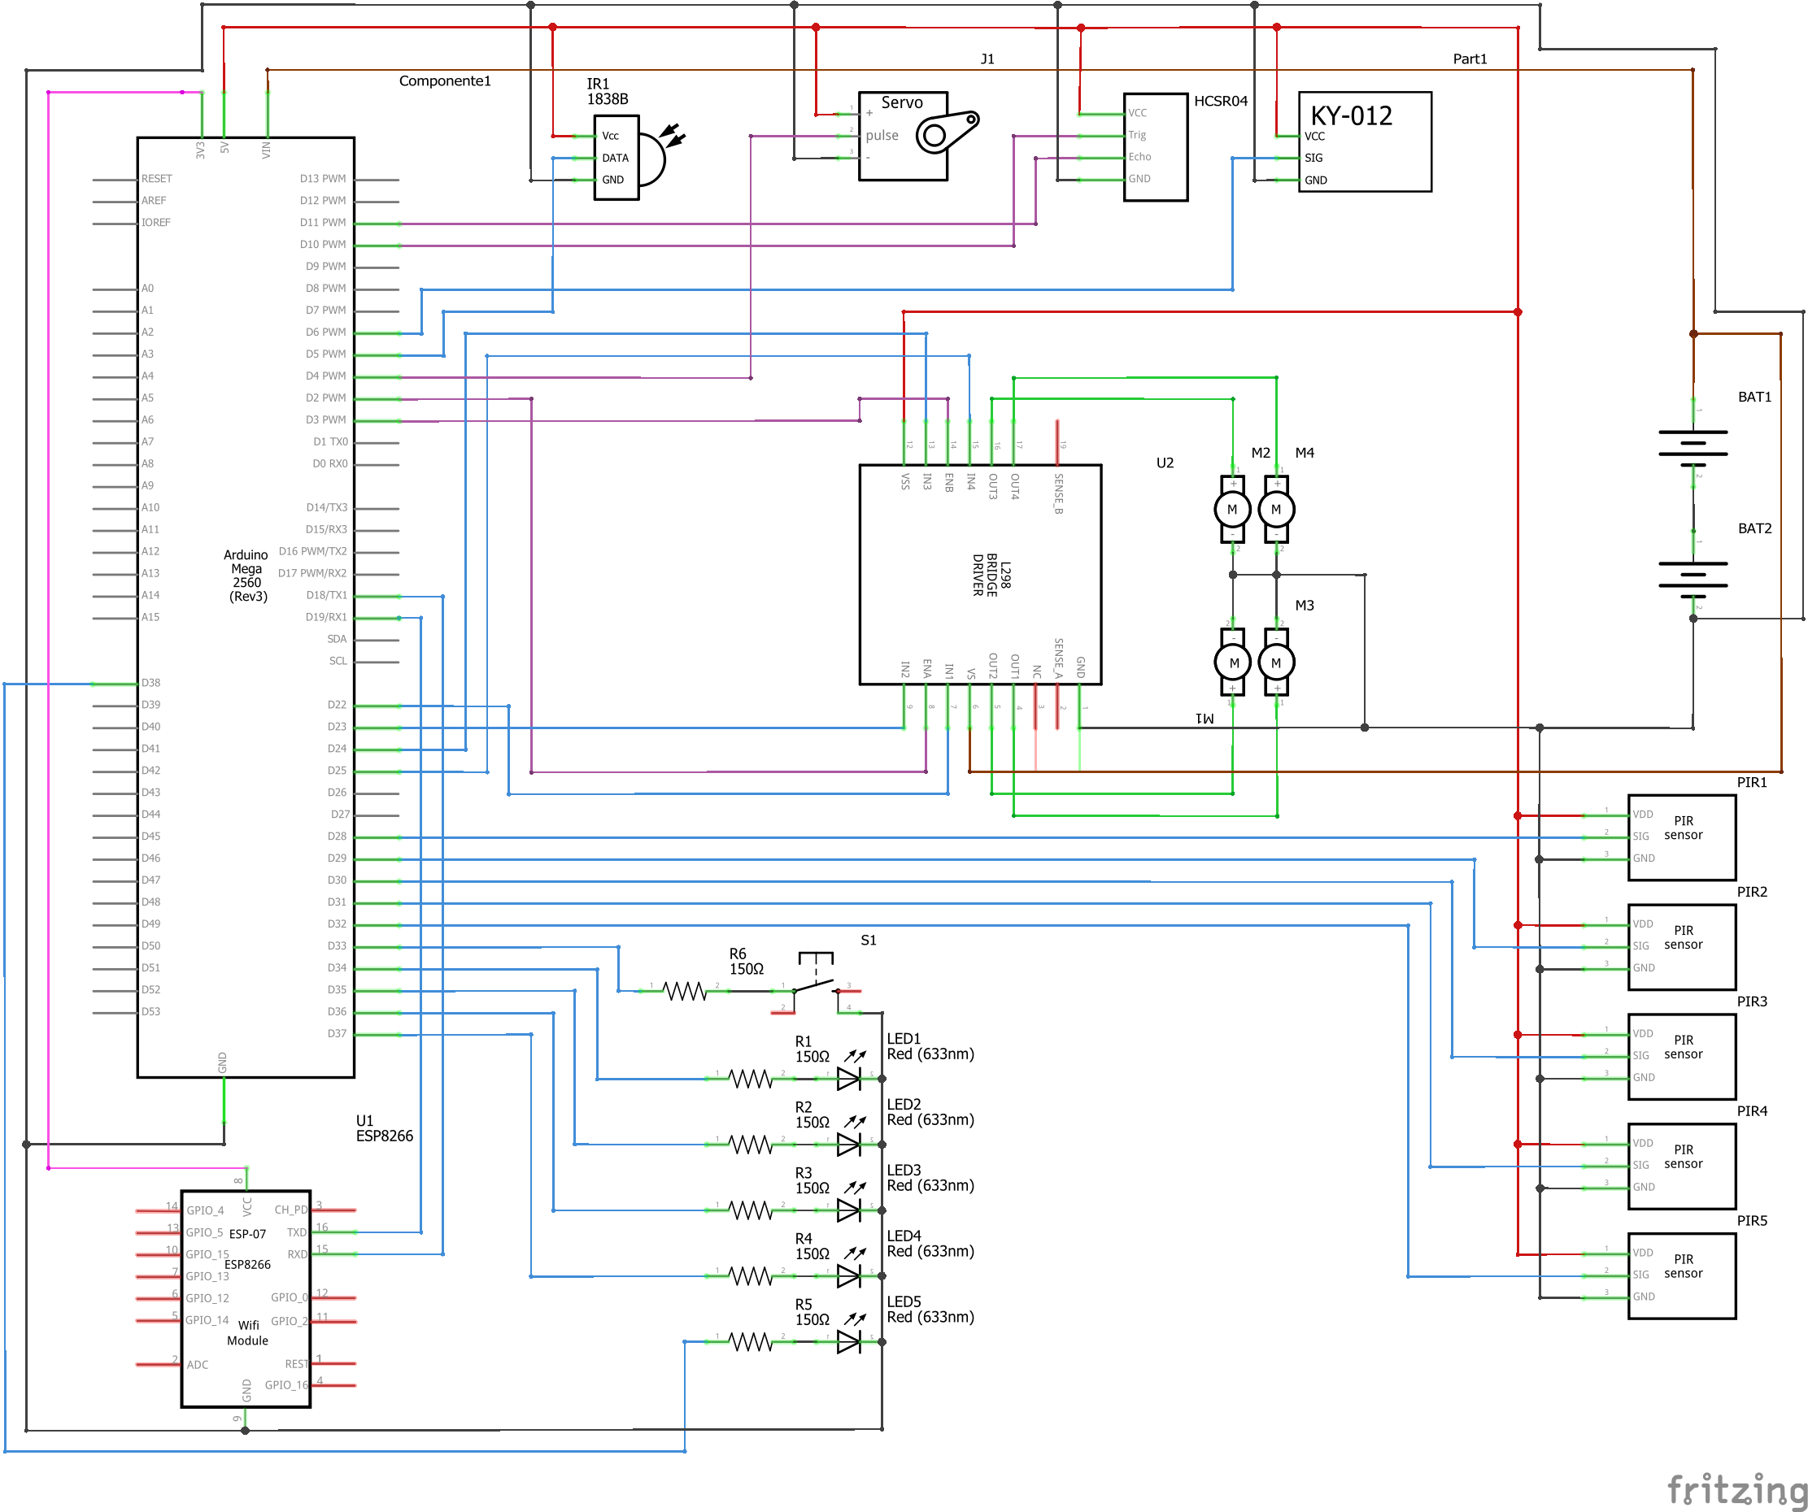
Schematics

Slide 17
Putting everything together:
The ESP-13 shield
(odissey)

Slide 18
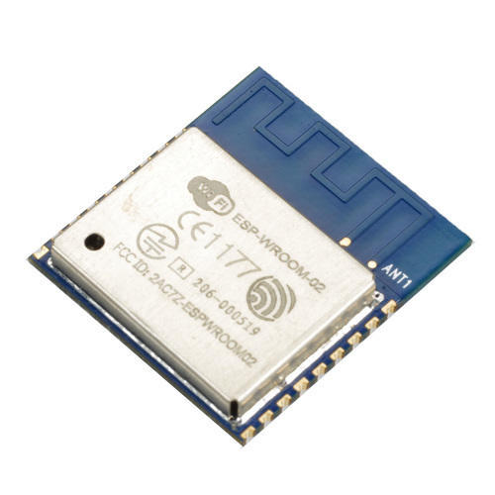
The ESP shield
The ESP-13 is an Arduino Uno shield whith an embedded ESP-WROOM02 module.
The ESP-WROOM02 by Espressif is an integrated WiFi 802.11 b/g/n module designed for providing wireless connection to embedded systems, it’s powered by an ESP8266EX chip, a 32 bit low-power microcontroller, with 2MB of onboard memory and can be programmed with the Arduino IDE.
ESP-13 by Jaycar offers a breakout for all the pins of the ESP-WROOM02, an onboard voltage divider for powering the ESP-WROOM02 itself (Arduino offers a 5V line but ESP8266 uses 3.3V signals both for powering and GPIO communication) and a level shifter for the logic signals coming from and to the Arduino.
Or at least it should…

Slide 19
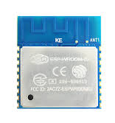
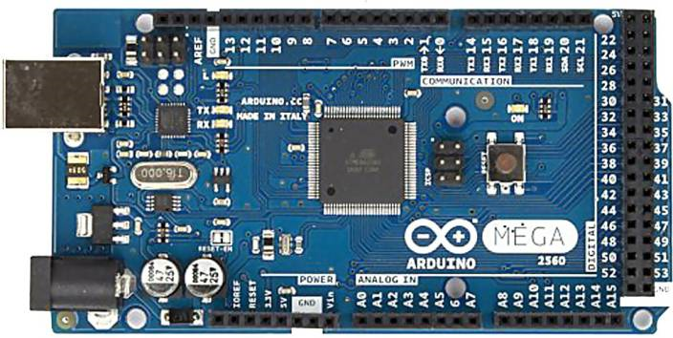


The ESP shield
The RX and TX pins on the shield, corresponding to the pins 0 (RX) and 1 (TX) in the Arduino layout were actually switched, rendering impossible to use the shield in it’s intended configuration.
RX
TX
RX0
TX0
RX
TX
RX0
TX0

Slide 20
The ESP shield
Possible solutions:
Trash the whole thing
Tempting but not very cost-effective
Fix the onboard traces
Scrape the soldermask to expose the traces
cut the traces in two different points
run two jumper wires
Time-consuming
I didn’t have any small-diameter wire laying around that day
Just connect it using jumper wires
Lazy solution
Automatically best solution

Slide 21
The ESP shield
5V > 5V
GND > GND
RX 1 > TX0
TX 1 > RX0

Slide 22
The ESP shield
5V (ARDUINO)
3.3V
(ESP8266)
The onboard voltage regulator should convert the 5V power provided by arduino and convert it to a 3.3V line that can be used by the ESP8266
BUT WAIT
The serial lines on the ESP8266 should also use 3.3V logic: we need a level shifter so that 5V signals from the Arduino can be translated to 3.3V for the ESP8266 and vice versa.
or do we?

Slide 23


The ESP shield
I remembered seeing some years a go a post on hackaday.com discussing wether the ESP8266 was actually 5V tolerant: people were using the ESP8266 serial lines with 5V logic without consequences
Didn’t remember the post saying anything definitive at the time, but just for the sake of it I decided to look back.

Slide 24
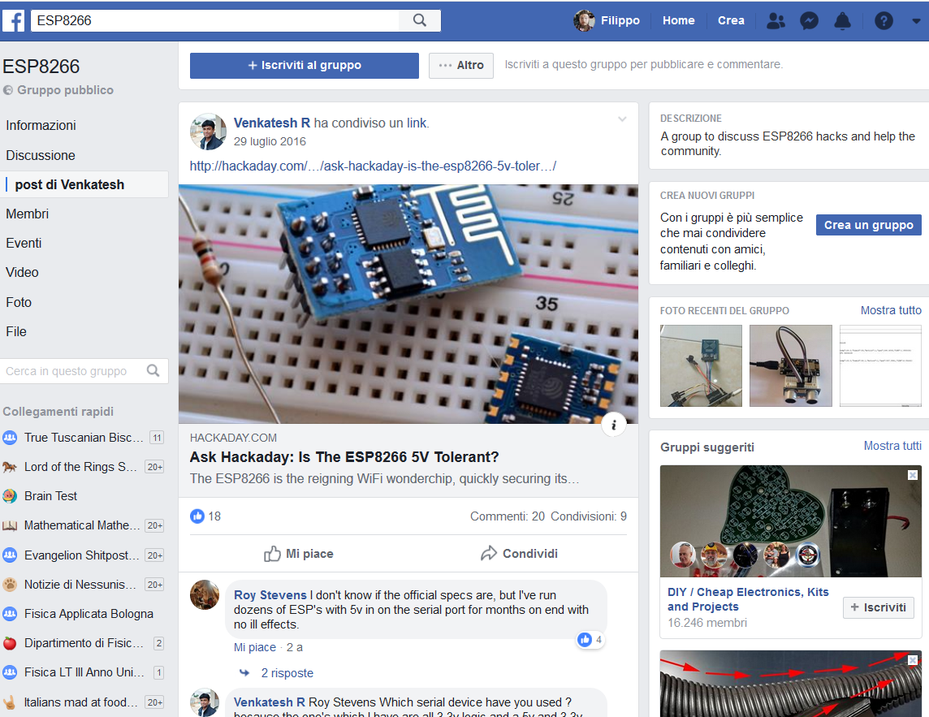

The ESP shield
With the benediction of the Espressif CEO I could finally lazily connect my ESP8266 to 5V logic without any remorse

Slide 25
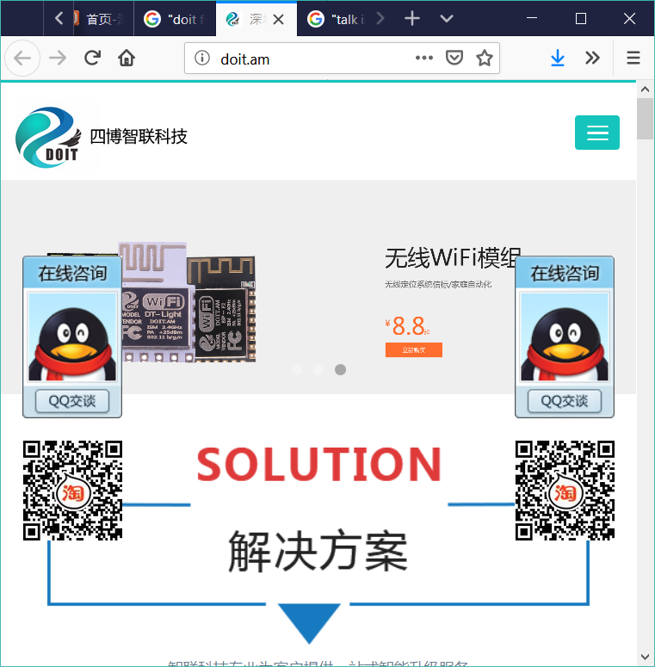

The ESP shield
Ok, that looks good, can we finally use the ESP8266?
nope
To be programmed using the Arduino IDE, the ESP8266 needs the AT Firmware by Espressif
Turns out the ESP8266 came pre-flashed with the chinese DOIT firmware

Slide 26
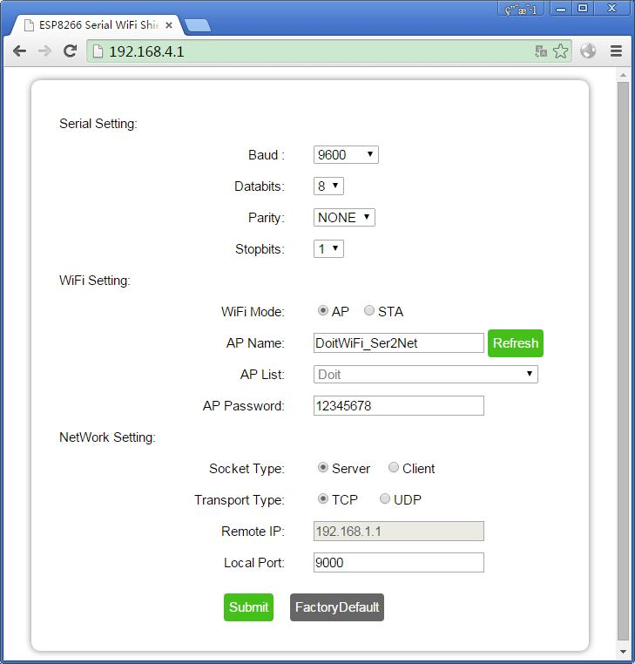
The ESP shield
It’s not a bad firmware per-se, but it does only one thing (and actually does it well):
Configures the ESP8266 to act as an access point
Starts a webserver on 192.168.4.1 and streams a nice config page from there
Listens on the serial connection
Encapsules every received sequence in a TCP package and streams it on the webserver.
But that’s not what we need!

Slide 27

The ESP shield
DOIT configuration
our configuration
turn right!
turn right!
* turns right *

Slide 28
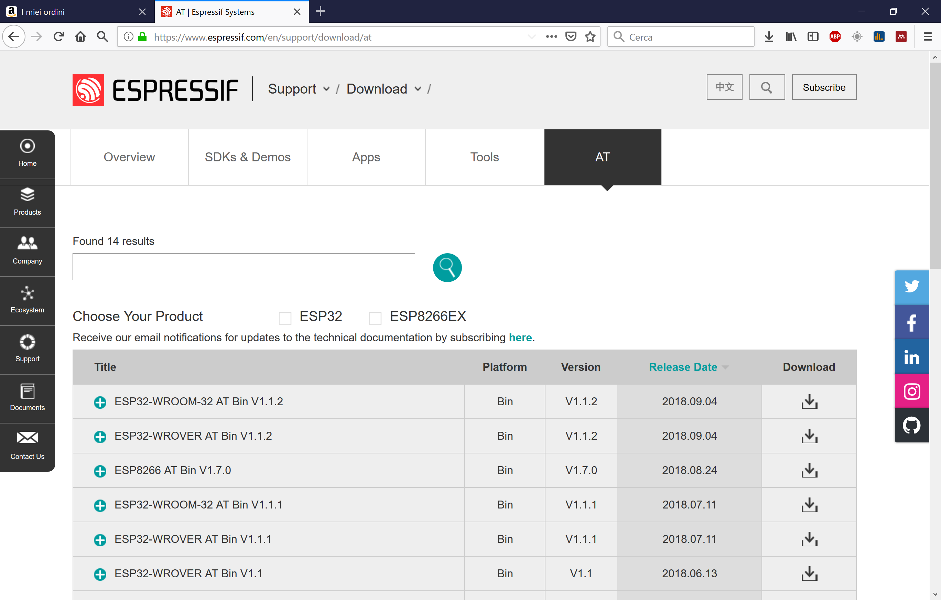
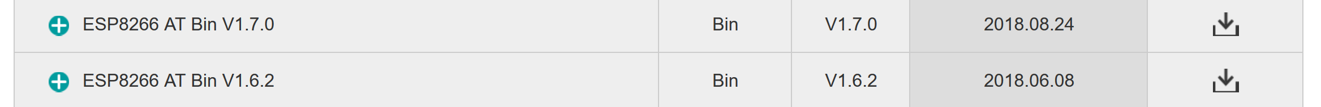
The ESP shield
We need to flash the AT firmware:
It can be downloaded from the Espressif website at www.espressif.com along with the firmware flashing tool: easy peasy no?
kinda...

Slide 29
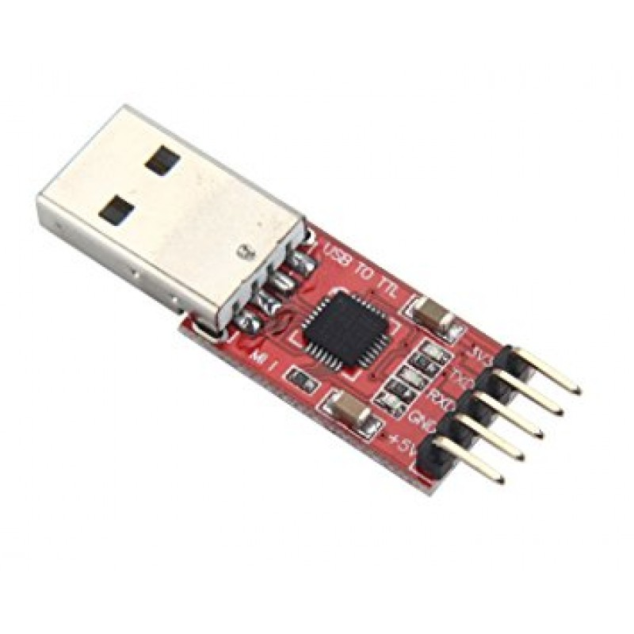

The ESP shield
How do we connect the ESP8266 to the pc?
The ESP-WROOM02 doesn’t have it’s own USB-UART hardware, like the Arduino has, so it needs some kind of USB-TTL interface to be programmed, they’re quite cheap to purchase on any online shop...
...but we’re both broke and lazy.
We can use what we already have: Arduinos!
Arduino has it’s own USB-TTL interface to program the onboard Atmel ATMEGA328P, we can use that instead of purchasing a USB-TTL adapter.
How to use what we have?

Slide 30
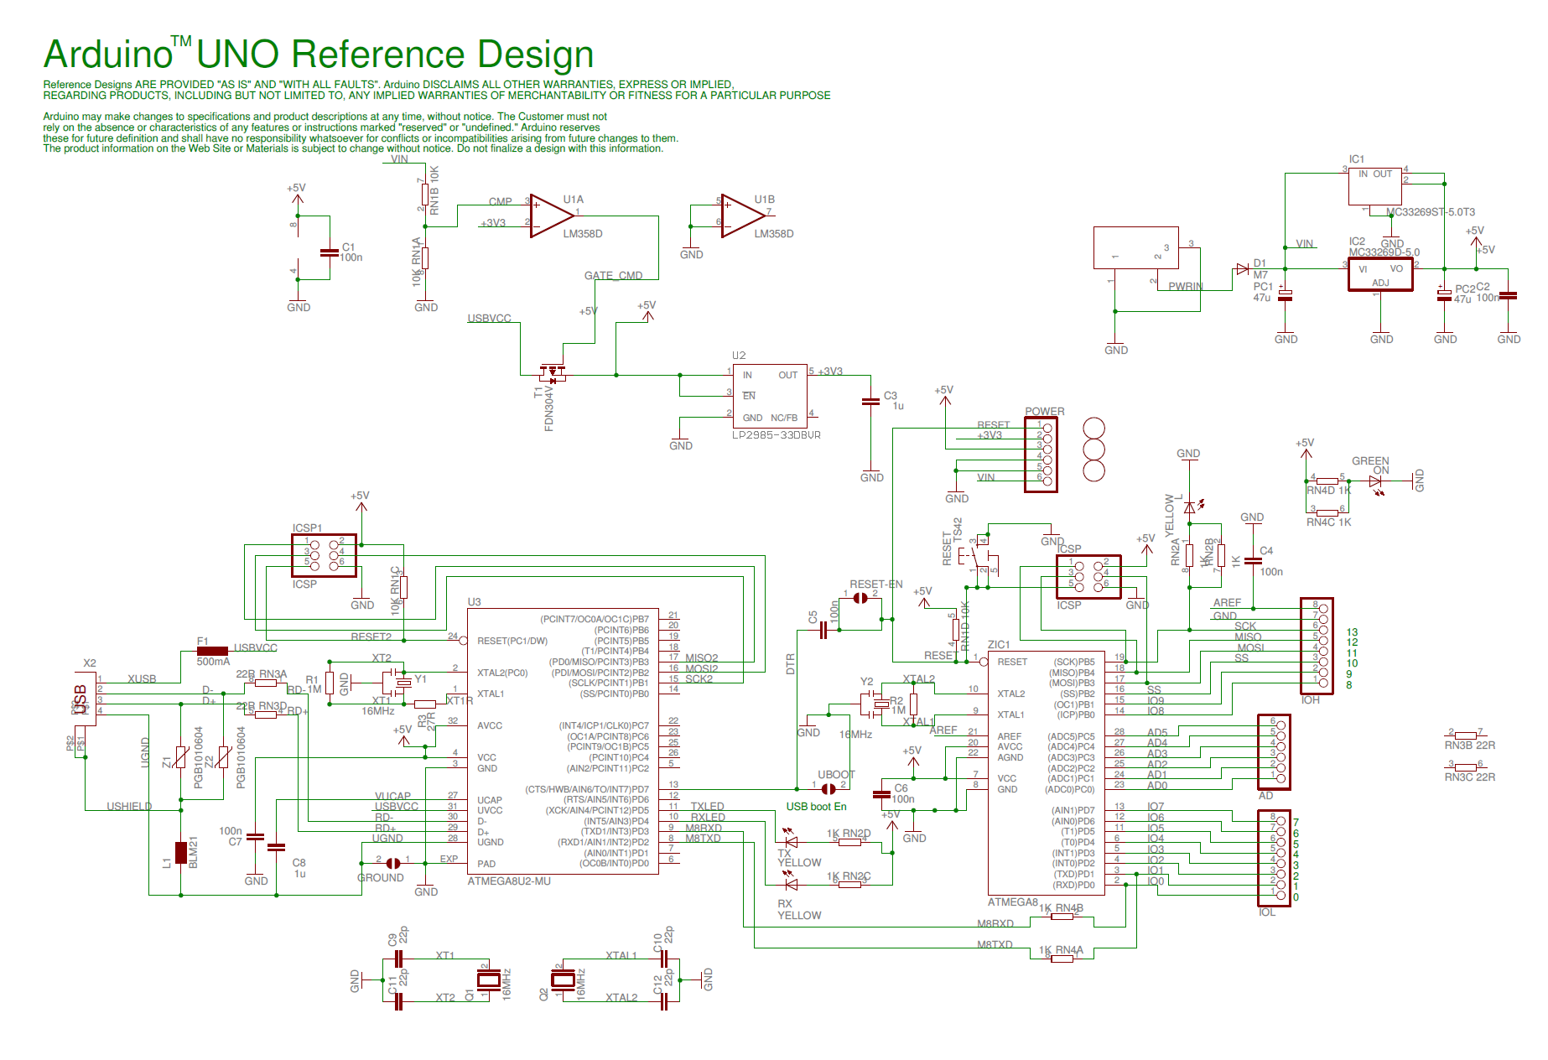
The ESP shield
How do we connect the ESP8266 to the pc?
Let’s take a look at the Arduino uno schematics:
This is clearly power-related stuff we don’t care for...
These are the interesting parts:
The ATMEGA controller
The USB-TTL adapter

Slide 31
The ESP shield
How do we connect the ESP8266 to the pc?
The D+ and D- differential data lines reach the USB-TTL interface:
we can then decide to program the chip talking via the ISP programmer or using the serial, interacting with the ATMEGA328P’s bootloader

Slide 32

The ESP shield
How do we connect the ESP8266 to the pc?
The PD0 and PD1 pins of the ATMEGA328P are exposed as pin 0 and 1 on the Arduino board!
That solves part of our economical problems as we probably won’t have to buy a USB-TTL adapter!
The ESP8266 can be flashed from serial:
when the GPIO0 pin is held on LOW(GND) it will execute a serial bootloader which will receive the programs we want to flash from the Espressif Flash Tool.

Slide 33
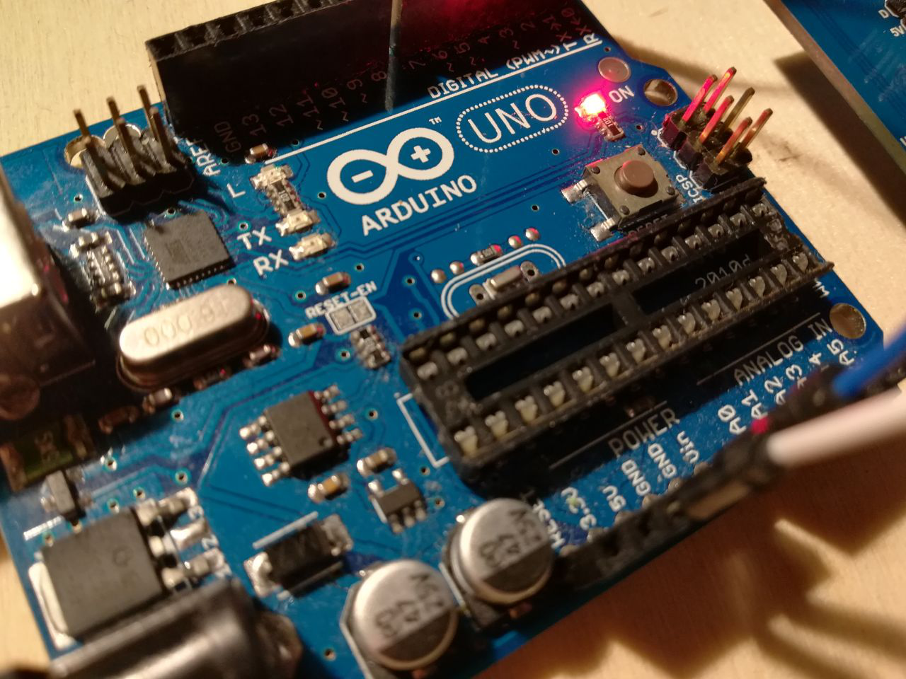
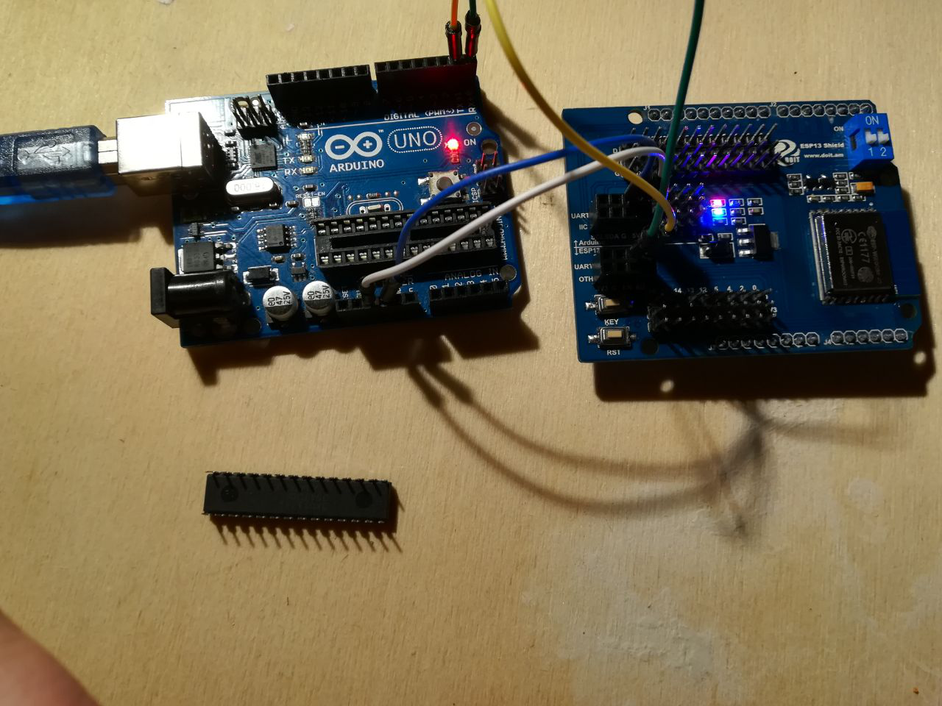
The ESP shield
How do we connect the ESP8266 to the pc?
We now need a practical method to adapt the USB-TTL interface to our needs:
Method 1: The Literal No-brainer
Remove the ATMEGA328P from it’s socket
Power up the ESP8266 connecting the 3.3V line to the Arduino 5V through the voltage regulator as we did before
Connect the RX and TX pins of the ESP8266 to the Arduino
We’re not trying to communicate with a the arduino but are trying to talk directly to the USB-TTL chip, the right connection scheme now is RX0 -> RX, TX0 -> TX!
That looks good if we have a socketed controller line in the Uno case, but what about the Mega?

Slide 34
The ESP shield
How do we connect the ESP8266 to the pc?
The Mega has a soldered ATMEGA2560 controller that might be little bit impractical to remove.
Method 2: The Sleeping Beauty
If we can’t remove the controller itself we can just silence it when we need to speak with the ESP8266 by grounding it’s reset signal.
Run a jumper wire between RESET and GND
Proceed exactly as Method 1

Slide 35
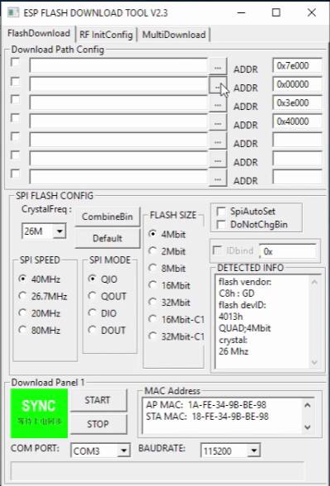
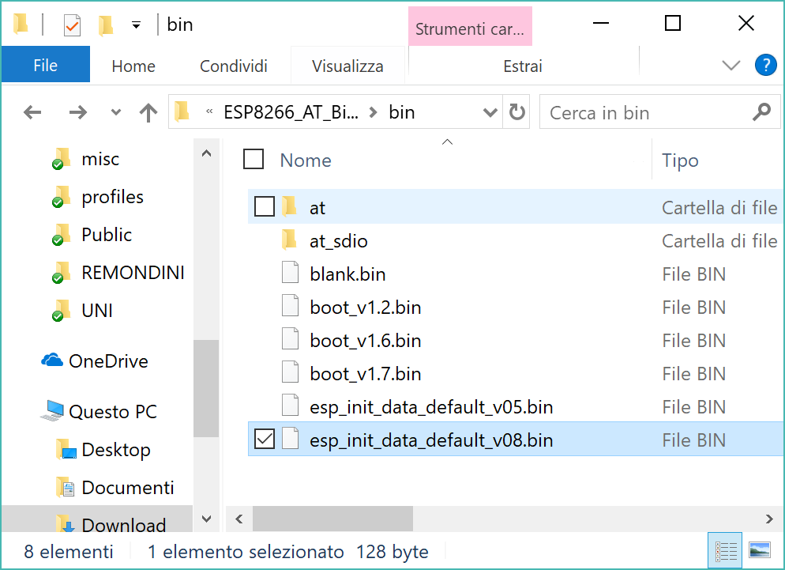
The ESP shield
Now we can finally proceed to flash the AT firmware on the ESP-WROOM02.
The AT firmware comes with a bunch of files to be flashed at different positions in the memory map

Slide 36
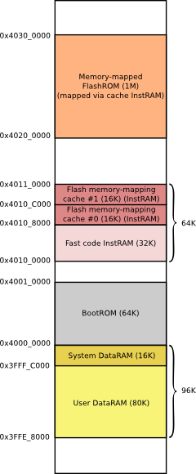
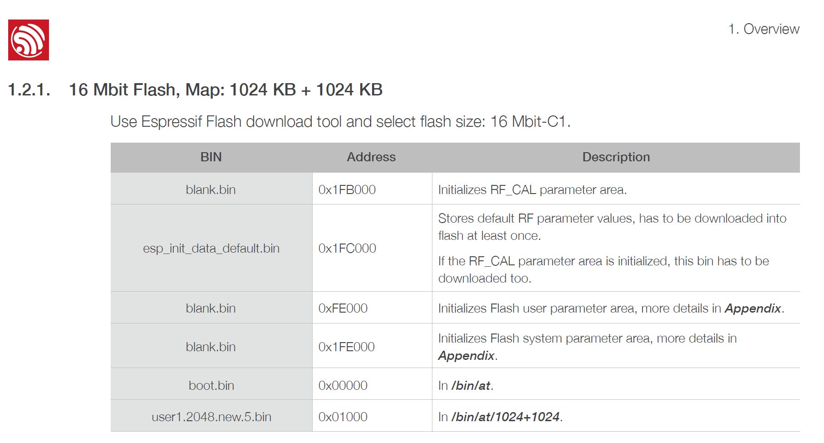
The ESP shield
The documentation by Espressif helps to choose which .bin is flashed to which memory address as memory can be organized differently from package to package

Slide 37
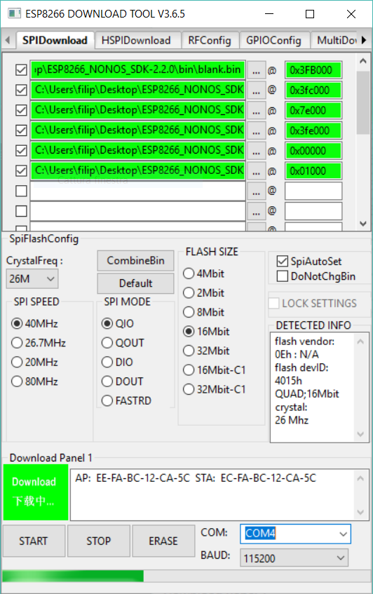
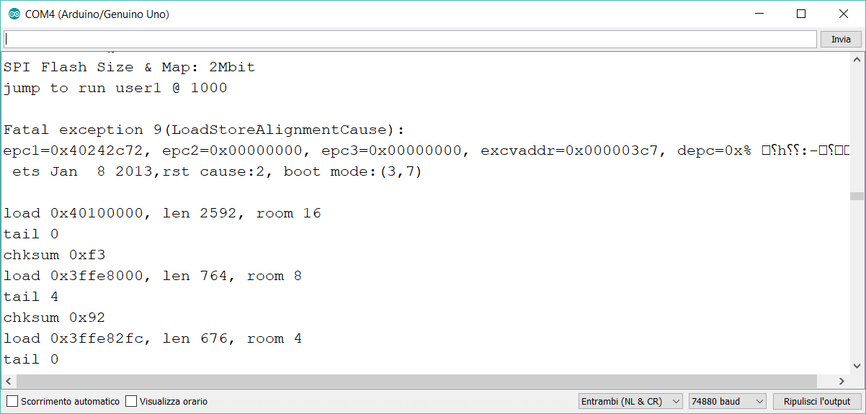
The ESP shield
Just define your memory map flashing schedule and a few parameters like
the communication port you’re using
the baud rate
various characteristics of the ESP8266 package can be detected automatically by the tool
it can take a while to figure out the correct settings and the correct firmware version to use for your specific chip.

Slide 38
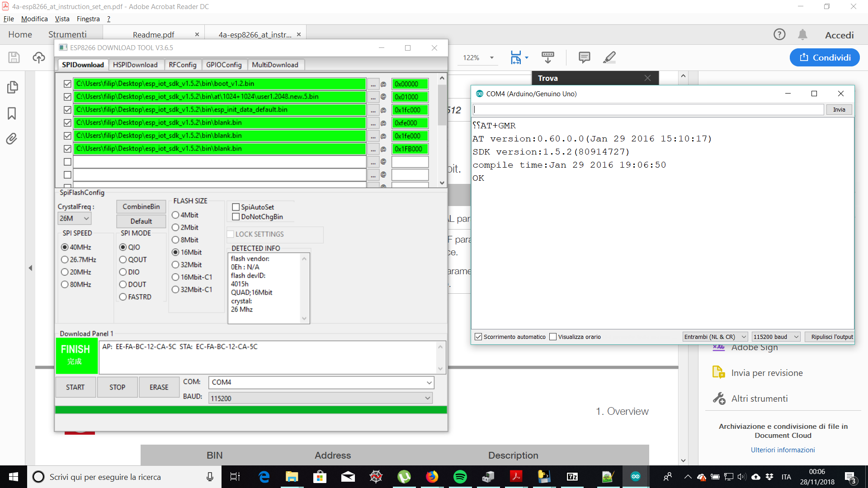
The ESP shield
If the firmware is flashed correctly, when sending the command AT+GMR? on serial the ESP8266 should reply with the current firmware version.
Using serial commands you can change settings without needing to reflash a program everytime.

Slide 39
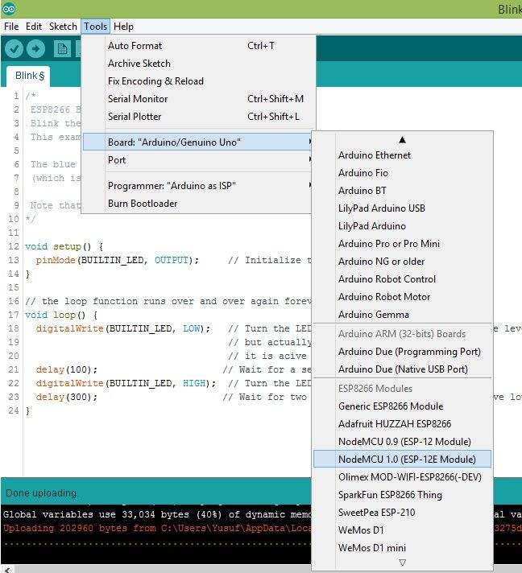
The ESP shield
We can now develop a program for the ESP8266 module directly in the Arduino IDE! (it requires some extensions available on the Arduino website) using the same C++ language you use for normal Arduino programming:
We set up a webserver wich streams a simple webpage which we use to control the car.
To flash your program you just need the same setup we used to flash the firmware (Arduino IDE only flashes a memory region allocated to program execution).

Slide 40
The ESP shield
We can now develop a program for the ESP8266 module directly in the Arduino IDE! (it requires some extensions available on the Arduino website) using the same C++ language you use for normal Arduino programming:
We set up a webserver wich streams a simple webpage which we use to control the car.
To flash your program you just need the same setup we used to flash the firmware (Arduino IDE only flashes a memory region allocated to program execution).

Slide 41
Layout titolo e contenuto con grafico

Slide 42
Layout due contenuti con tabella
Primo punto elenco qui
Secondo punto elenco qui
Terzo punto elenco qui
Classe | Gruppo 1 | Gruppo 2
Classe 1 | 82 | 95
Classe 2 | 76 | 88
Classe 3 | 84 | 90

Slide 43
Layout titolo e contenuto con SmartArt
Titolo fase 1
Descrizione attività
Titolo fase 2
Descrizione attività
Titolo fase 3
Descrizione attività

Slide 44
Aggiungere un titolo di diapositiva - 1

Slide 45
Aggiungere un titolo di diapositiva - 2

Slide 46
Aggiungere un titolo di diapositiva - 3

Slide 48
Aggiungere un titolo di diapositiva - 4

Slide 49
Aggiungere un titolo di diapositiva - 5

